Slide 1

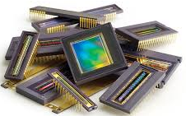
Long Exposure Time Noise in Pinned Photodiode CMOS Image Sensors Digital Design and Verification
Submitted to : Prof. S. Indu
Submitted by:
Sumedha (2K19/SPD/17)
Sudiksha Shukla (2K19/SPD/25)

Slide 2
INTRODUCTION
RESEARCH PAPER :
Long Exposure Time Noise in Pinned Photodiode CMOS Image Sensors by Liqiang Han and Jiangtao Xu, 10.1109/LED.2018.2839711, IEEE, 2018.
A Charge Transfer Model for CMOS Image Sensors, IEEE Trans. Electron Devices by L. Han, S. Yao, A.J. P. Theuwissen, 10.1109/TED.2015.2451593.
ABOUT : In this presentation we focus on:
A new noise source (Long Exposure Time Noise) within a pinned photodiode in CMOS image sensors.
The cause of this noise source: Feedforward effect
TCAD simulations using the Monte Carlo method showing how the barrier height varies with CMOS process
How to improve the long exposure time noise performance of the device.

Slide 3
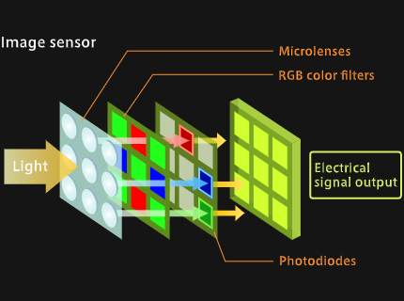
CMOS IMAGE SENSORS
A CMOS sensor is an electronic chip that converts photons to electrons for digital processing.
CMOS (complementary metal oxide semiconductor) sensors are used to create images in digital cameras, in the fields of electronic imaging, such as consumer, scientific, and military applications.

Slide 4
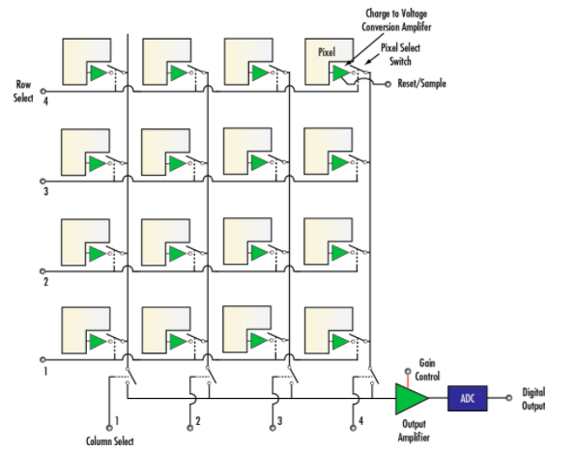
WORKING OF CMOS IMAGE SENSORS
A CIS has a photodiode and a CMOS transistor switch for each pixel, allowing the pixel signals to be amplified individually
CMOS transistors perform the functions of resetting or activating the pixel, amplification and charge conversion, and selection or multiplexing.
In a CMOS sensor, the charge from the photosensitive pixel is converted to a voltage at the pixel site and the signal is multiplexed by row and column to multiple on chip ADCs.

Slide 5
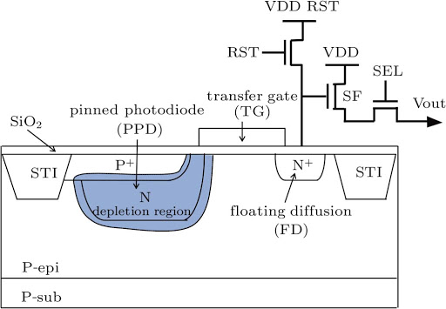
CISs AND PINNED PHOTODIODES
The pinned photodiode (PPD) is the most important component in a CIS. The implants of the PPD and the transfer gate (TG) must be accurately controlled and optimized for the purpose of low image lag, low dark current, and large full well capacity (FWC).
TG is a transistor where the source and the drain correspond to the PPD and the FD.
SF – Source Follower
RST – Reset
SEL – Row select
STI – Shallow trench isolations
A typical 4-transistor pixel structure including the PPD, TG and the FD node

Slide 6
CISs AND PINNED PHOTODIODES
Photo-sensitive element- PPD is associated to a TG, which isolates the PPD from FD during light integration (TG Off) and enables e- transfer from PPD to FD for the readout of the O/P charge (TG on).
The PPD is a buried junction photodiode formed by a double p+np junction, due to which the PPD potential VPPD is “confined” between the surface potential and the PPD maximum potential (pinning voltage - Vpin).
This means that if the PPD is suddenly connected to a deeper potential well (Vwell>Vpin), VPPD starts increasing as charges are being transferred to the neighboring potential well, until VPPD = Vpin.
Thanks to this potential floor, true charge transfer can be achieved in PPDs, whereas with standard photodiodes, only charge sharing is possible.
FD performs the charge to voltage conversion.

Slide 7
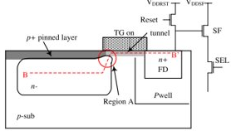
CISs AND PINNED PHOTODIODES
The BB' is the charge transfer path when a high voltage is applied to the TG.
Several implants, including p+ for the pinned layer and n− for the PPD, affect the potential distribution in region A, where a barrier may occur.

Slide 8
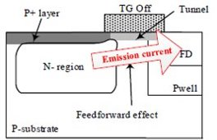
CISs AND PINNED PHOTODIODES
The emission current originates from the thermal motion phenomenon of electrons, where the electrons which have enough thermal velocity in the transfer direction will cross the barrier on the charge transfer path.

Slide 9
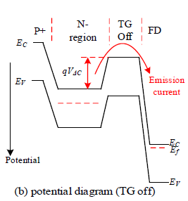
CISs AND PINNED PHOTODIODES
The corresponding potential diagram along the emission current path during the exposure phase :
The barrier height qVΔC should be sufficiently large to hold the photo-induced electrons collected in the PPD.

Slide 10
FEED FORWARD EFFECT
The feedforward effect is a non-ideal characteristic of the PPD that affects the effective full well capacity (EFWC) of the PPD.
The feedforward effect, is explained by the thermionic emission theory.
This effect arises from the emission current flowing from the PPD to the FD node.
During the exposure phase, both
the photogenerated current inside the PPD and
the emission current from the PPD to the FD node,
exist if the barrier height is not high enough.

Slide 11
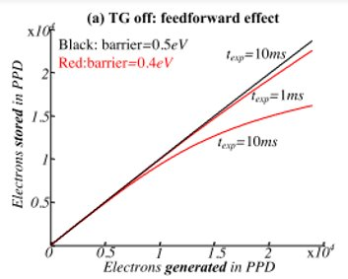
FEED FORWARD EFFECT ​ ​
A greater barrier height and shorter exposure time texp will increase the equivalent FWC of the PPD during the exposure phase.

Slide 12
ALREADY EXISTING NOISES IN PPD CISs
Dark Current noise: Dark current noise is the constant current that exists even when no light is incident on the photodiode. It occurs due to the collected signal in the dark due to thermal generation and diffusion. For high temperature or long exposure time applications, the dark current should be as low as possible to achieve a high signal-to-noise ratio.
Shot Noise: Shot noise, also known as quantum noise, arises from the statistic nature of photodetection. Reason of the shot noise is fluctuations in the dark current . These fluctuations are because of randomness of electrons i.e. the electrons are produced in different time and in different areas of photodiode, so the current which is produced by these electrons has fluctuations.
Thermal Noise: Thermal noise, also known as Johnson noise, is generated by the heat generated in load resistor. It is mainly present on receiver side and hence highly affects the Signal to Noise Ratio

Slide 13
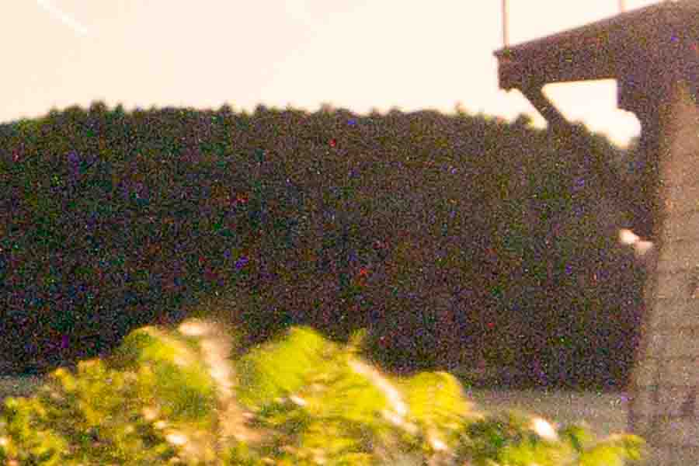
NEW NOISE SOURCE IDENTIFIED: LONG EXPOSURE TIME NOISE
The long exposure time noise originates from the feedforward effect, which is related to the barrier height under the transfer gate during the long exposure phases.
The simulations show that a lower barrier height and a longer exposure time leads to a more severe feedforward effect.
Image with long exposure time noise

Slide 14
SIMULATIONS
Simulations are done using Monte Carlo Method.
MONTE CARLO METHOD -
Monte Carlo Simulation is a mathematical technique that generates random variables for modelling risk or uncertainty of a certain system.
The random variables or inputs are modelled on the basis of probability distributions such as normal, log normal, etc.
It is a probabilistic method for modelling risk in a system. It is never deterministic.
SIMULATION PROCESS -
Four devices are simulated using the same process flow.
The four devices work under the same applied voltage and on same pixel
Since all devices have variations due to CMOS manufacturing process fluctuations even for the same pixel, so in simulation different devices with a slight doping variation are taken in order to accommodate for CMOS manufacturing process fluctuation.

Slide 15
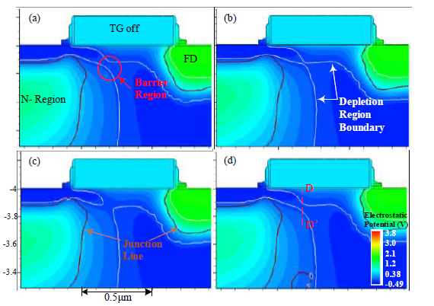
RESULTS
For same pixel and same voltage applied barrier region height is different for all four devices
A slight difference in the potential distribution is observed, particularly in the barrier region.

Slide 16
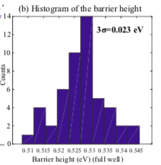
SIMULATIONS & RESULTS
Same simulation method and parameters are now applied on 50 samples
Fig shown is the histogram of the barrier heights under full well conditions.
The barrier height between the PPD and the FD node during exposure phase is not constant even for the same pixel design and the same applied voltage.
This parameter exhibits fluctuation in the spatial domain.

Slide 17
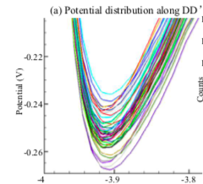
SIMULATIONS & RESULTS
To simplify, we assume that the barrier height follows a normal distribution and that the potential of the FD node is sufficiently high during the exposure phase so that the emission current is unidirectional.
Fig shown the potential distribution along DD’ (barrier height between PPD and FD).

Slide 18

SIMULATING FEED FORWARD EFFECT
The feedforward effect can be simulated using equation:
Where,
q -> electron charge
Ne -> number of electrons in the PPD
qVΔC -> barrier height during the exposure phase
qVΔC0 -> barrier height when Ne is equal to the full well capacity
Ε -> permittivity of silicon
ND -> doping concentration of the N- region
2d -> depth of the PPD undepleted region under full well condition
Sppd -> cross-sectional area on the emission current path.
For the long exposure time noise simulation, we assume that qVΔC0 follows a normal distribution N(μ, σ^2), where μ is the mean of qVΔC0 and σ^2 is the variance.

Slide 19
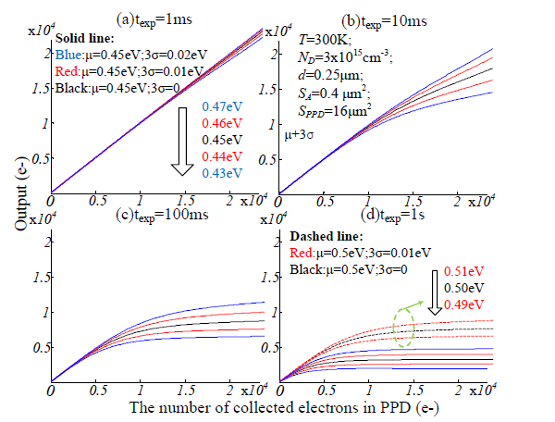
SIMULATIONS & RESULTS
The figure shows the simulation results of the photo response curves for long exposure time noise.

Slide 20
SIMULATIONS & RESULTS
Here, the photo-induced electrons are generated at the beginning of the exposure phase.
The x-axis shows the number of collected electrons in the PPD at the very beginning.
The y-axis shows the output (100% transfer) or the number of residual electrons in the PPD at the end of the exposure phase.
The solid black curves represent the situation where μ=0.45 eV and σ=0, corresponding to no process fluctuation in the pixel array.
To observe the effect of long exposure time noise, photo response curves with ±3σ are presented.
The solid red curves represent situations where μ=0.45 eV and 3σ=0.01 eV and blue curves represent μ=0.45 eV and 3σ=0.02 eV.

Slide 21
SIMULATIONS & RESULTS
In the small signal region, the variation of qVΔC0 has almost no influence on the feedforward effect, particularly for shorter exposure times.

Slide 22
SIMULATIONS & RESULTS
In the large signal region, the variation of qVΔC0 leads to a variation of the sensitivity, which can be interpreted as the variation of the EFWC.
The sensitivity variation grows with increasing signal amplitude or exposure time. Thus, it can be considered as a noise source in spatial domain.
The noise also results in a reduced output range under long exposure time situation, as shown in Fig. (a-d). ​
In addition, from a comparison of the dashed and solid curves in Fig. (d), we conclude that a larger barrier height can improve the long exposure time noise.​

Slide 23
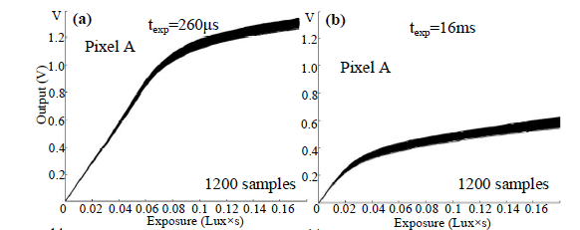
SIMULATIONS & RESULTS
Multiple frames were captured to reduce the influence of temporal noise.
We see the effect of the long exposure time noise as the reduced output range.
If the pixel is affected by the long exposure time noise,then a longer exposure time leads to a lower output range.

Slide 24
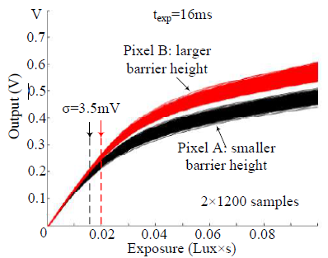
TO IMPROVE DEVICE'S LONG EXPOSURE TIME NOISE PERFORMANCE:
The figure shows the influence of the barrier height on the noise.
The difference between pixel A and pixel B are the doping profiles under the TG.
The p-type doping concentration of pixel B is slightly higher, resulting in a larger barrier height during the exposure phase.
Pixel B, which has a larger barrier height, shows an improved long exposure time noise performance.

Slide 25
CONCLUSION
The barrier height has a prominent impact on the feedforward effect in the PPD.
Here, we characterized the variation of the barrier height with CMOS process fluctuation.
The noise exhibits a strong relationship with the barrier height and the length of the exposure time.
The results show that the long exposure time noise has a smaller influence on the pixel performance in the small signal region.
However, the noise is easily observed if the exposure time is sufficiently long particularly in the large signal region.
A pixel design with a larger barrier height improves the noise performance.

